Slide 1
AI Based Pluggable
Chatbot
Presented By:
Dishan Shrestha, 181409
Rinku Deuja, 181450
Sadhika Kasaju, 181432
Simran Tamrakar, 181444

Slide 2
Outline
Problem Statement
Project Objectives
Significance of Study
Scope and Limitation
Literature Review
Methodology
Performance analysis and validation
Task and Time schedule
Project Output
Recommendation

Slide 3
Introduction
Pluggable chatbot that can be added as a widget in any pre-existing web application
Supports both Open Domain and Closed Domain Q&A
Can respond from a list of predefined responses or use Knowledge base to extract response

Slide 4
Problem Statements
Long Response Time
High Cost of Customer Service
Poor Service Quality
Limited Availability
Lack of Personalization

Slide 5
2. Project Objectives
Implement BERT model to provide intent based and extractive chatbot
Provide pluggable chatbot widget that can be integrated in all kinds of web applications
A scalable system that can provide custom solution to business of all sectors

Slide 6
3. Significance of Study
Provide 24/7 customer support
Allows user to engage in both open and closed domain Q&A
Works on both labelled and unlabelled text corpus
Instant response
Reduce confusion leading from lexical and grammatical errors
Increase customer engagement and conversion rate

Slide 7
4.1 Scope
Respond to FAQs
Automatic information extraction
Customer support
Set predefined answers as per business requirement

Slide 8
4.2 Limitations
Only supports English language
Accuracy depends upon text corpus for extractive chatbot
Some responses might be vague and error prone
Only supports texts

Slide 9
5. Literature Review
Chat GPT:
ChatGPT is an advanced language model developed by OpenAI. It is designed to generate human-like text responses given a prompt or input. The model has been trained on a vast amount of diverse text data from the internet, allowing it to learn patterns, grammar, and context from the data.
ChatGPT uses a transformer neural network, which is a type of deep learning model that
excels at processing sequential data, such as text.

Slide 10
SnapChat AI:
Snapchat's AI capabilities have evolved over time, driven by advancements in deep learning and computer vision research. The company invests in research and development to improve the accuracy, speed, and versatility of its AI models. Snapchat also collaborates with academic institutions and industry experts to explore emerging technologies and push the boundaries of AR and AI integration. One significant milestone in Snapchat AI's development was the acquisition of computer vision startup Looksery in 2015. This acquisition brought advanced facial tracking and AR effects to the platform, laying the foundation for Snapchat's iconic face filters.

Slide 11
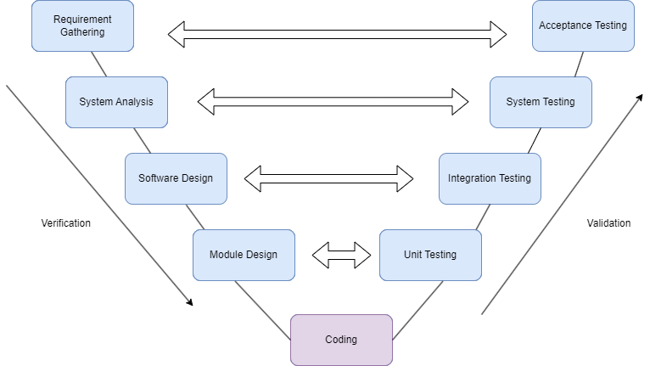
6. Methodology
V - Model

Slide 12
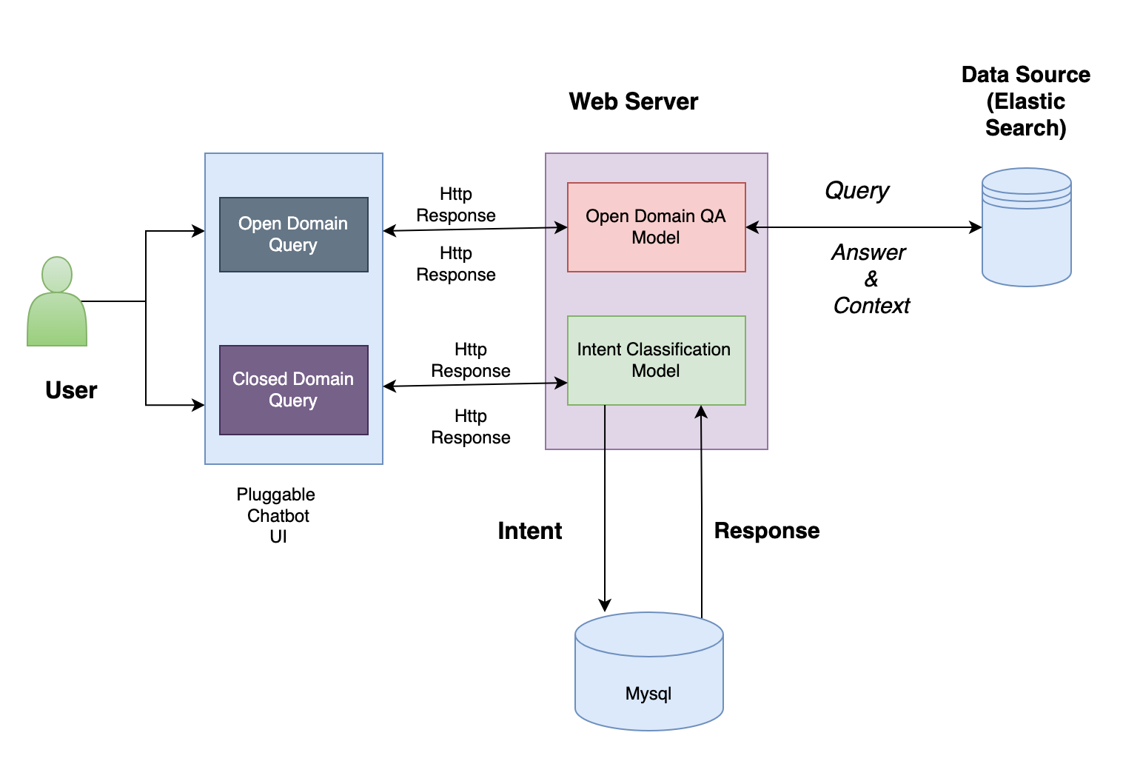
System Architecture

Slide 13
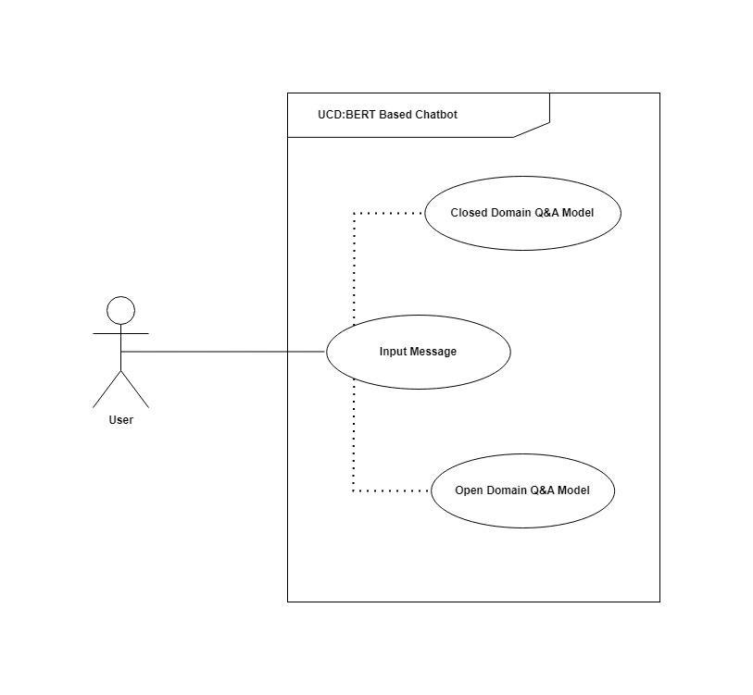
Use Case Diagram

Slide 14
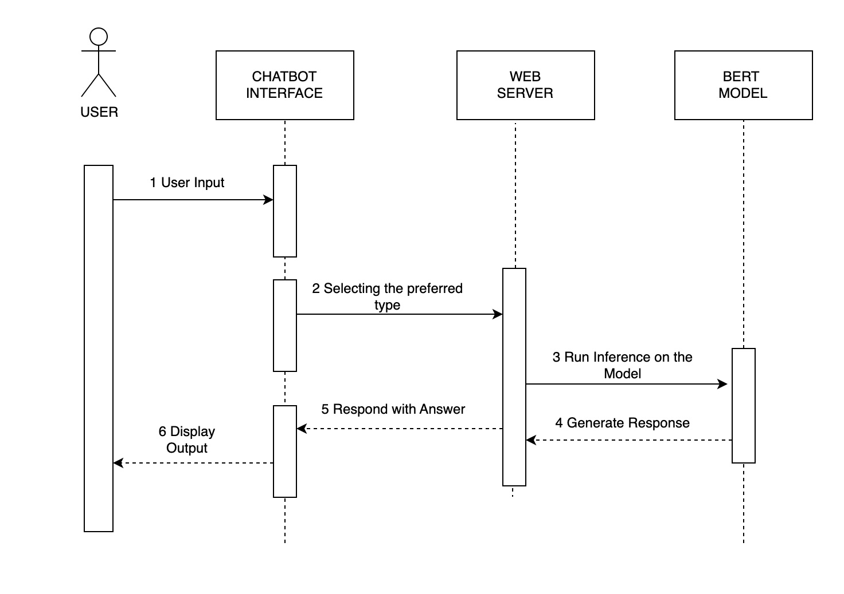
Sequence Diagram

Slide 15
6.2 Tools and Technologies
TOOLS | USAGE
React | Frontend UI
Fast API | Web Server
MySql | Database
Matplotlib | Graph Plot
TOOLS | USAGE
Tensorflow | Deep Learning Model
Elastic Search | Document Store
Haystack | Pipeline
Docker | Container Virtualization

Slide 16
6.3 Model/Algorithm
Model/Algorithm | USAGE
BERT | Intent Classification/ Reader
BM25 | Retriever

Slide 17
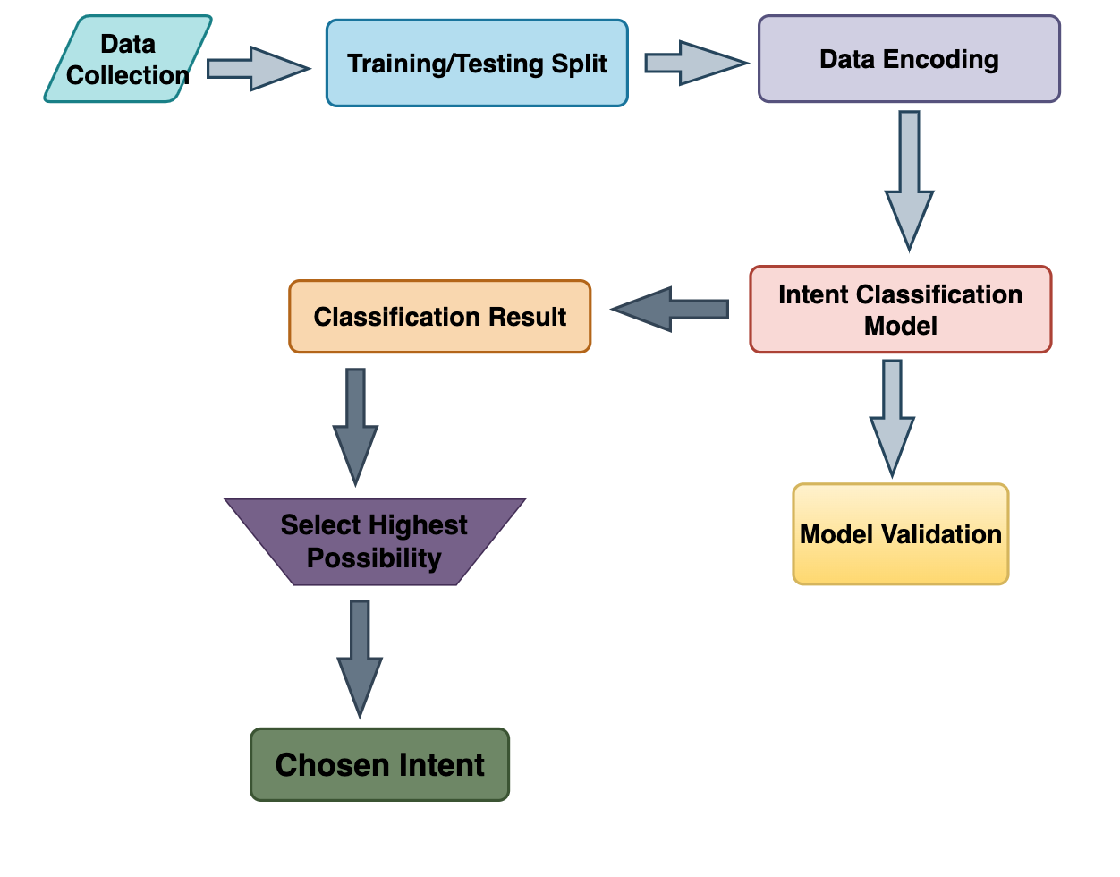
6.3 Intent Classification Flow Model

Slide 18
Data Source: Intent Model
S.N | Text | Intent
0 | Listen to westbam album allergic on google music | PlayMusic
1 | Add step to me to the 50 clasicos playlist | AddToPlaylist
2 | I give the current textbook a rating value of | RateBook
3 | Play the song little robin redbreast | PlayMusic
4 | Please add iris dement to my playlist this is | AddToPlaylist
5 | What will be the weather | GetWeather
6 | Play a popular chant by brian Epstein | PlayMusic
7 | Find a fishy story | SearchScreeningEvent
8 | Book a spot for 3 in mt | BookRestaurant

Slide 19
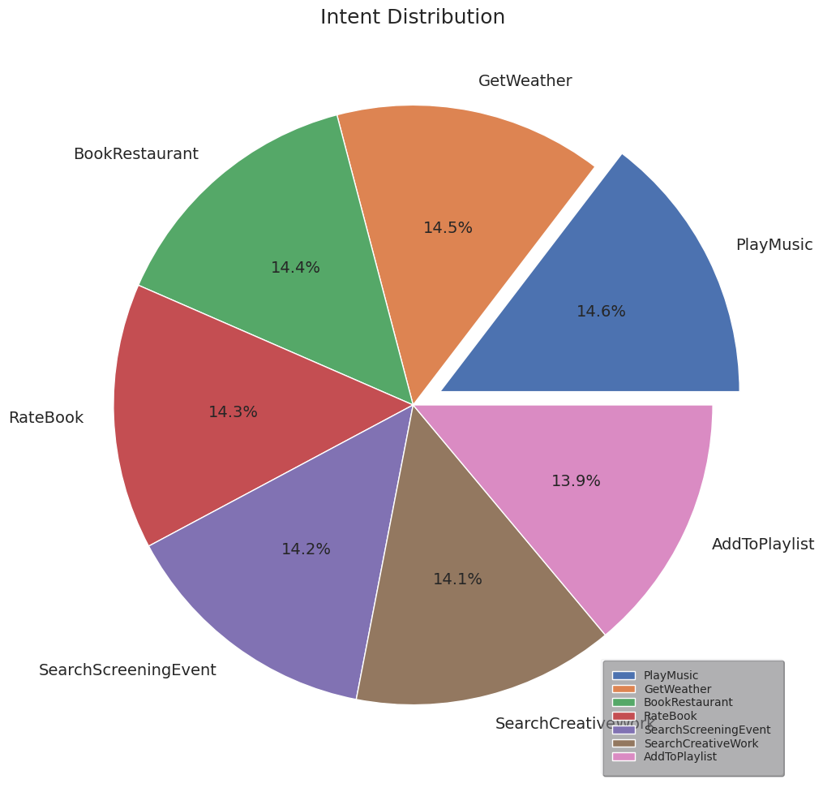
DATASET VISUALIZATION

Slide 20
Data preprocessing
Tokenize the sentence.
Add special tokens [CLS] at beginning and [SEP] at end.
Make sentence of same length by padding.
Create attention mask.

Slide 21
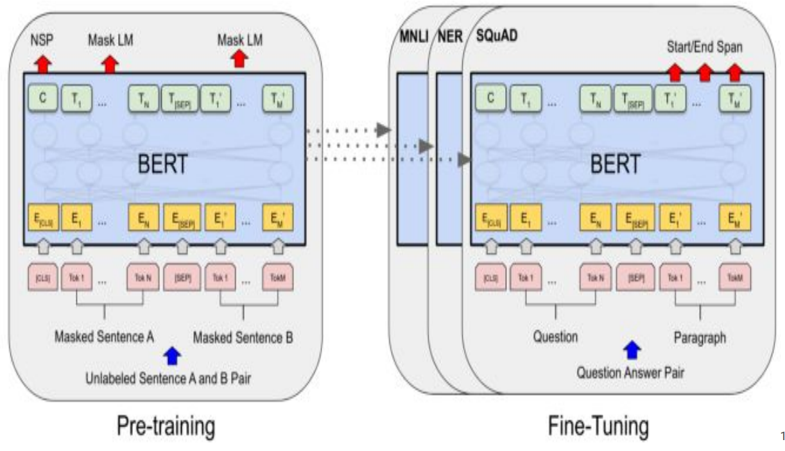
6.4 Bidirectional Encoder Representation from Transformer

Slide 22
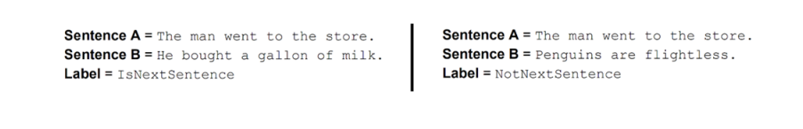
Pre Training BERT
To understand Language and context (WikiText Corpus)
Pre-training strategies:
Masked Language Modeling(MLM)
Model is fed with a large corpus of text and learns to predict masked words
Next Sentence Prediction(NSP)
Trained to learn semantic relationship between two sentences such as cause and effect, implication/contradiction between them.

Slide 23
Fine Tuning BERT
Training a pre-trained Bert model on a specific task/dataset
Use language for tasks like text classification, question answering, named entity recognition
Eg: intent classification, sentiment analysis

Slide 24
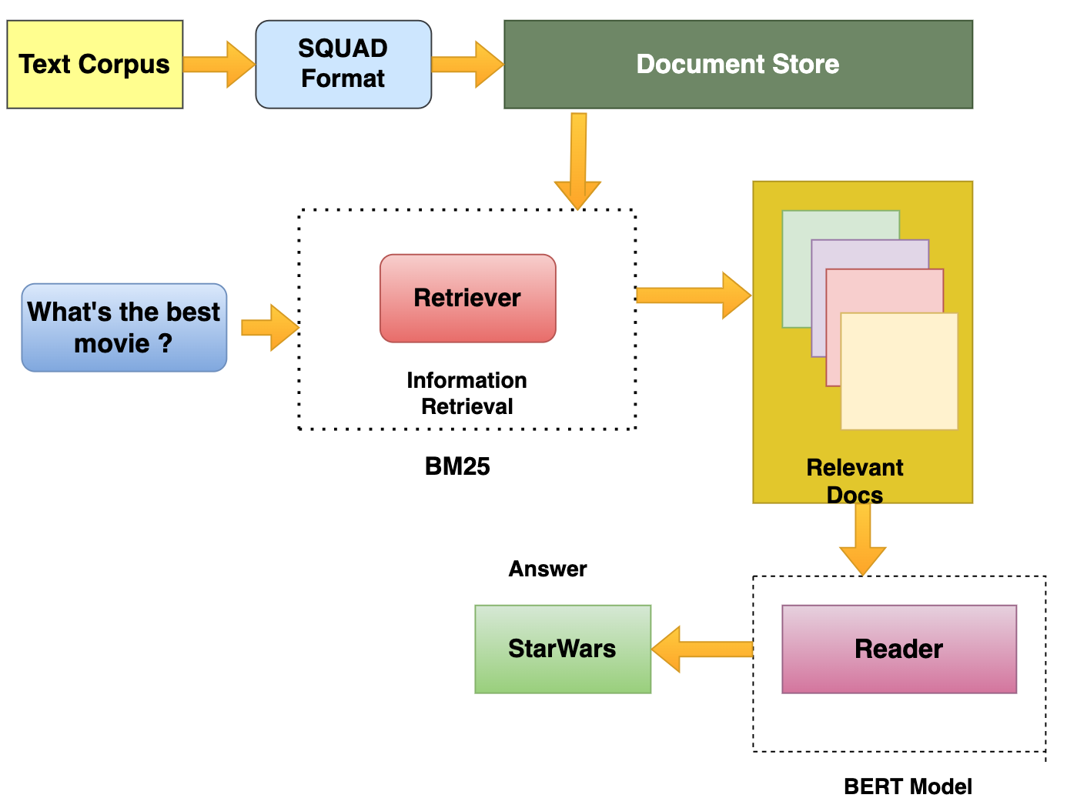
6.5 Extractive Q&A Pipeline

Slide 25
{ "data": [ { "paragraphs": [ { "context": "The quick brown fox jumps over the lazy dog.", "qas": [ { "question": "What does the fox jump over?", "id": "q1", "answers": [ { "text": "the lazy dog", "answer_start": 32 } ] } ] } ], "title": "Example" } ], "version": "2.0"

Slide 26
Data Source: SQuAD
Field | Description
id | tensor containing article id.
title | tensor containing title
Context | Tensor containing context from the title
question | tensor containing the question
text | tensor containing the text
answer_start | tensor that contains the starting index of the answer
is_impossible | A label that represents whether answering is possible or impossible.

Slide 27
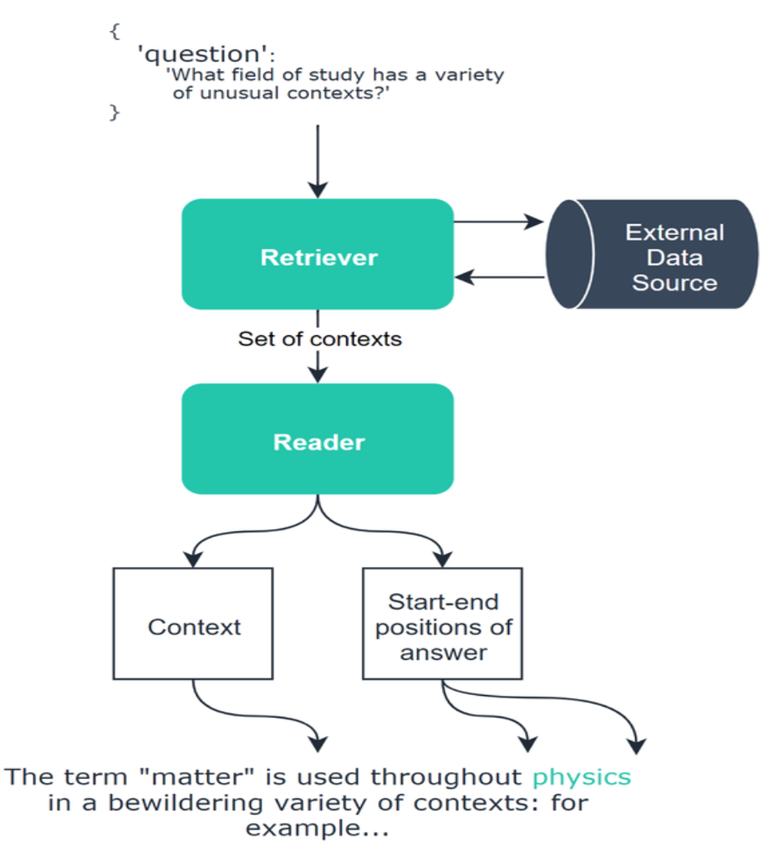
Open Q&A architecture

Slide 28
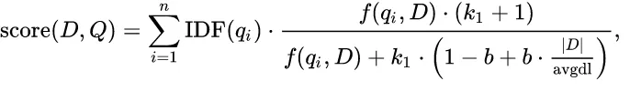
BM25
BM25 is a term-based ranking model that aims to provide accurate and relevant search results by scoring documents based on their term frequencies and document lengths. It can be mathematically expressed as

Slide 29
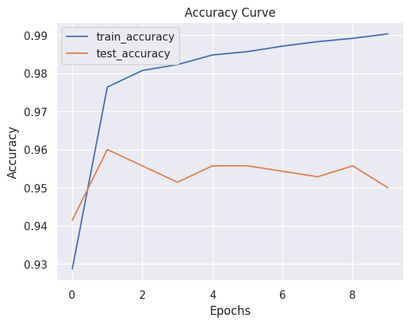
7. Performance Analysis and Validation
Accuracy Curve

Slide 30
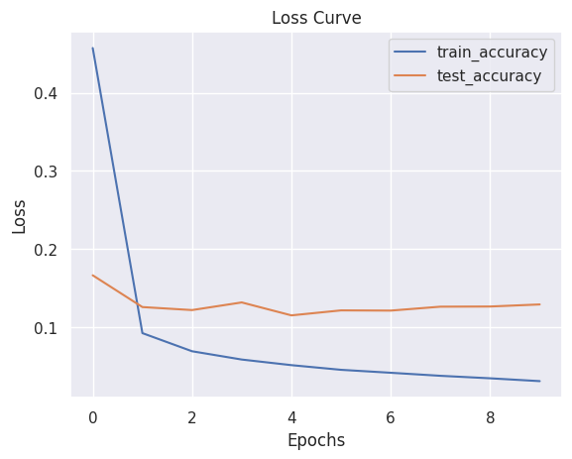
Loss Curve

Slide 31
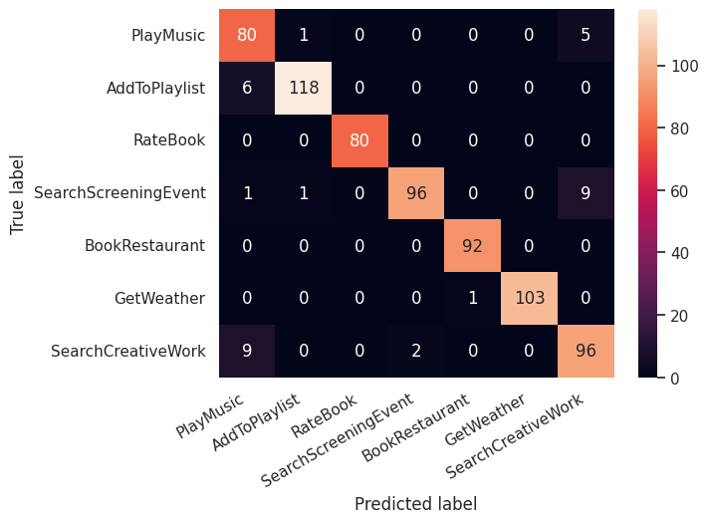
Confusion matrix

Slide 32
7.1 Rouge
ROUGE stands for Recall-Oriented Understudy for Gisting Evaluation. ROUGE is actually a set of metrics, rather than just one.
ROUGE-N
ROUGE-N measures the number of matching 'n-grams' between our model-predicted answer and a 'reference'.

Slide 33
ROUGE | F1 | Precision | Recall
ROUGE-1 | 0.759 | 0.733 | 0.8
ROUGE-2 | 0.549 | 0.521 | 0.6

Slide 34
8. Task and Time Schedule
Task | Start Date | End Date | Duration
Dataset Collection | 5/10/2023 | 5/17/2023 | 7
Dataset Pre-Processing | 5/15/2023 | 5/30/2023 | 15
Model Development | 5/31/2023 | 6/27/2023 | 27
Testing and Validation | 6/20/2023 | 7/2/2023 | 12
Documentation | 5/15/2023 | 7/10/2023 | 56

Slide 35
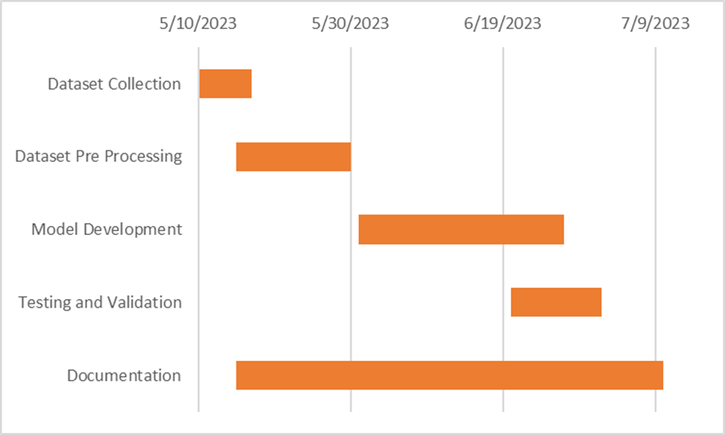

Slide 36
9. Recommendation
The project can be further enhanced with the following features:
● The project can be upgraded to a multilingual chatbot system.
● The chatbot can be enhanced to integrate images, gifs, and other interactive multimedia technologies to create better user experience.
● The model can be further fine-tuned to improve accuracy.

Slide 37
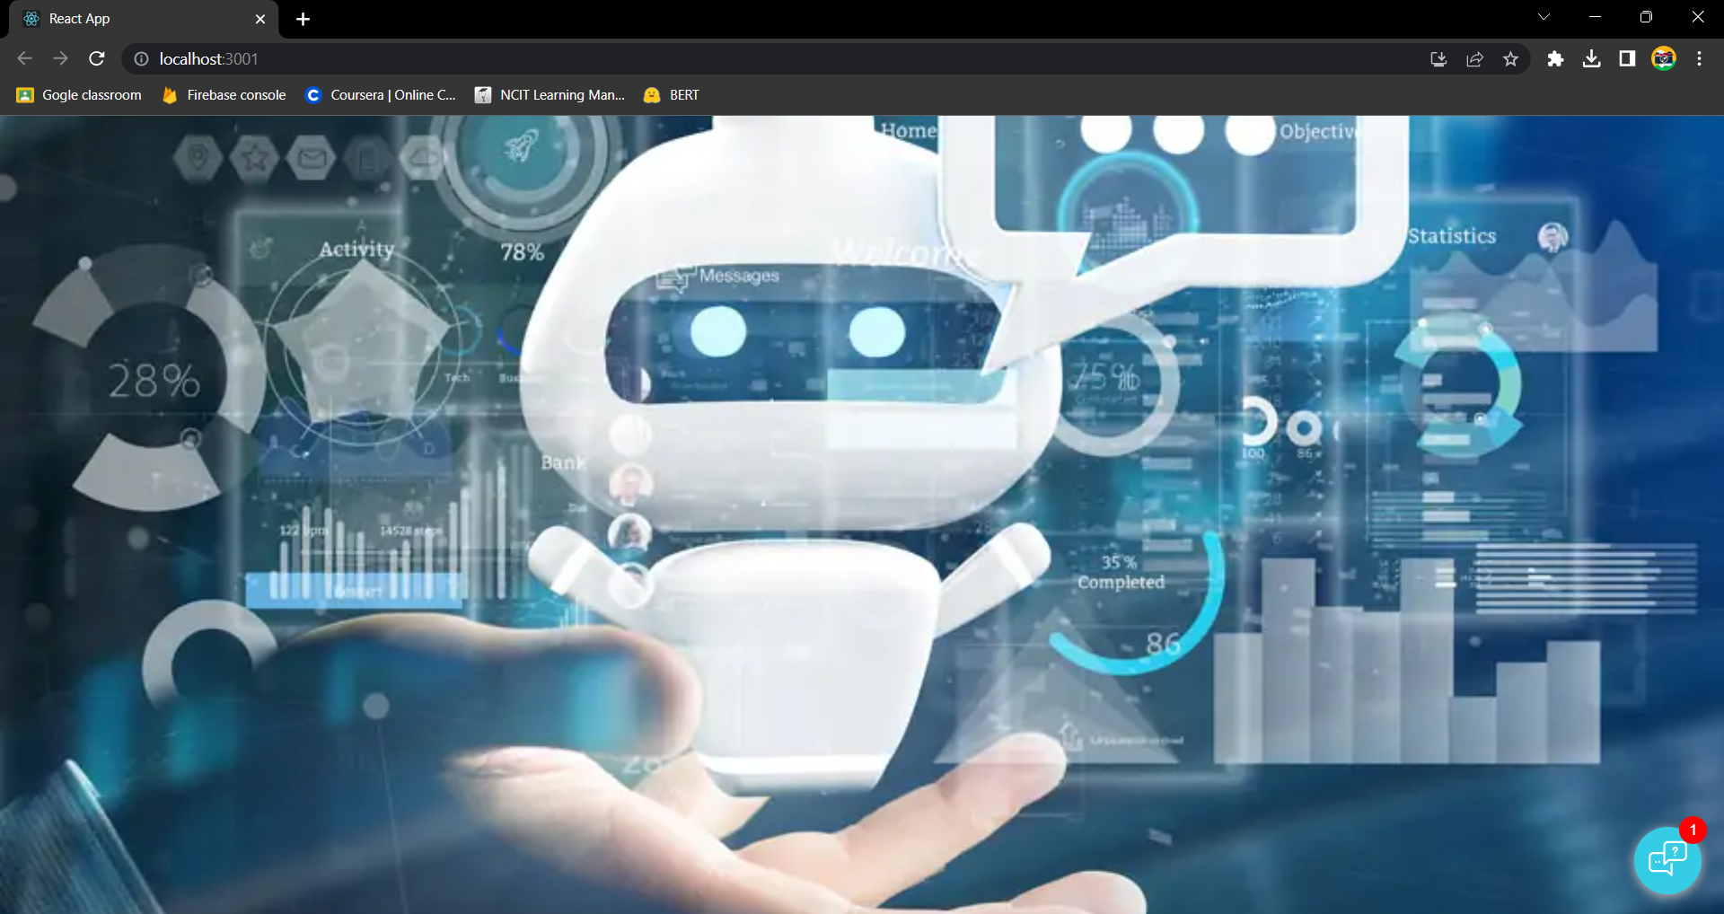
10. Project output
Homepage

Slide 38
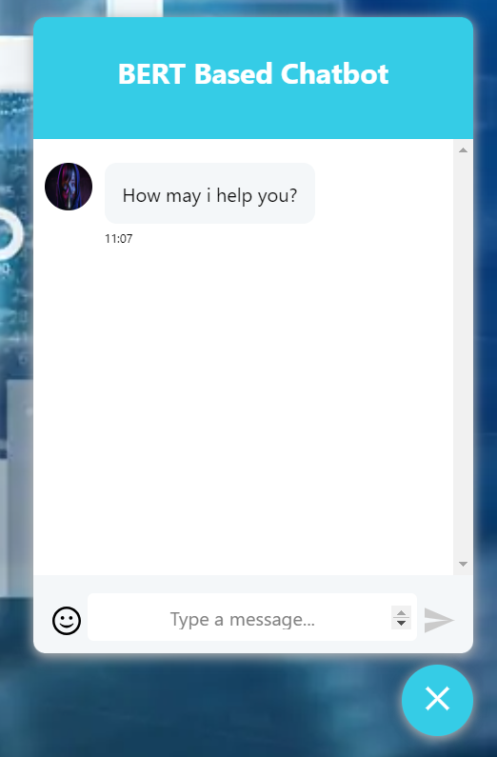
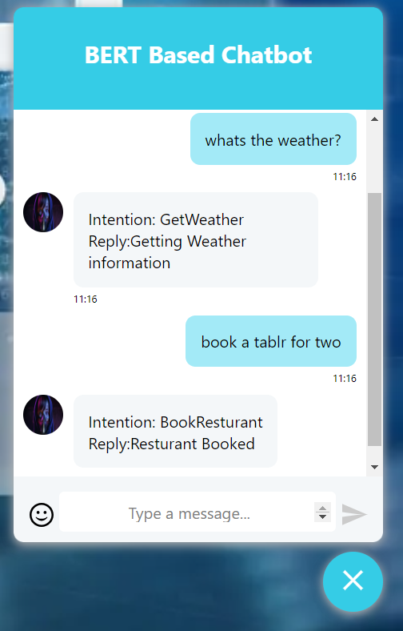
Chatbot popup
Intent chats

Slide 39
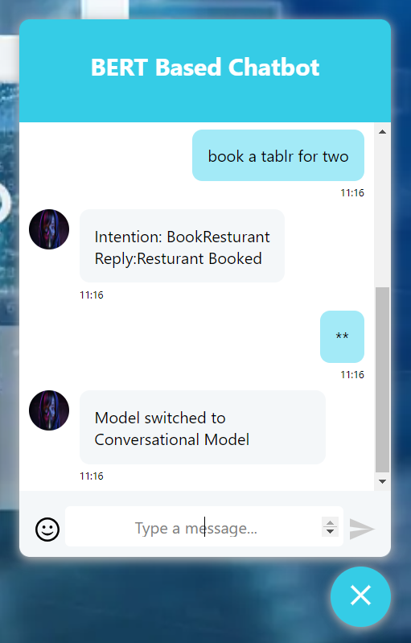
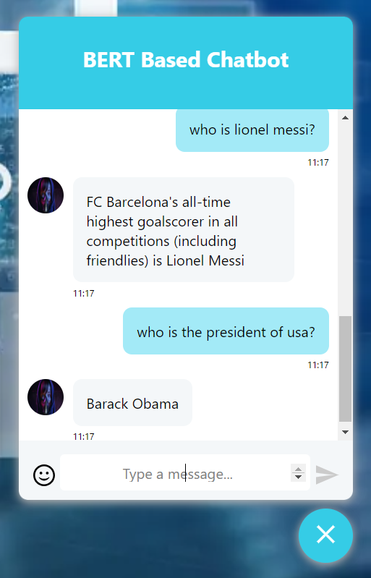
Model switch to conversational chat
Asking Queries about anything

Slide 40
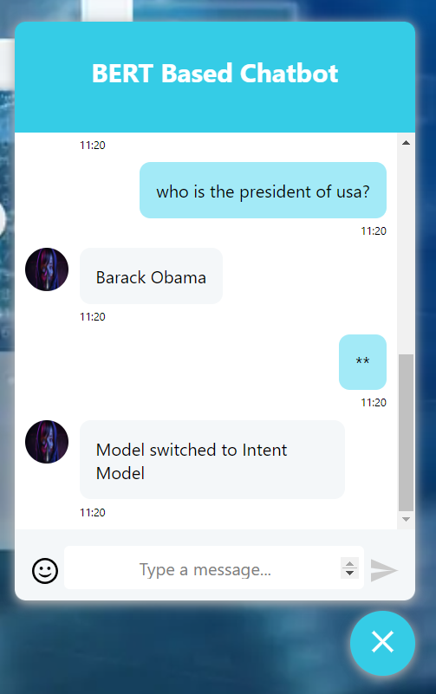
Model Switch back to Intent

Slide 41
THANK YOU!

